Slide 1

Artificial Intelligence
Lecture 2, Chapter 3 Solving Problems by Searching
SAZIA SHARMIN
Department of CS AIUB
AI

Slide 2
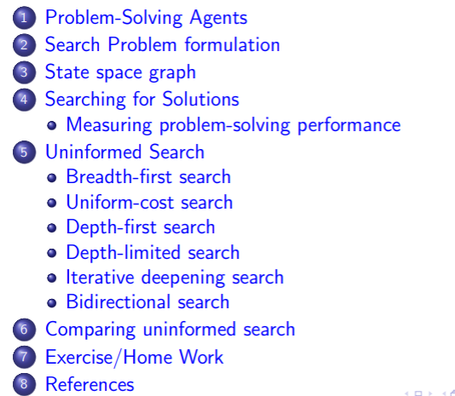
Table of Contents
7
AI

Slide 3
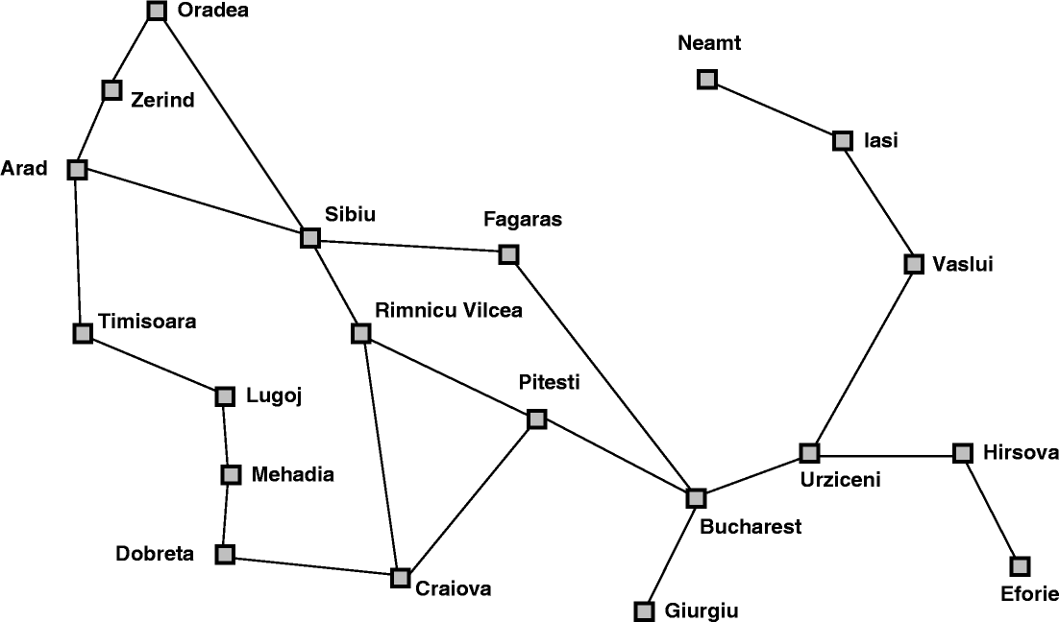
Problem Solving Agent
A problem-solving agent is one kind of goal-based agent.
Lets consider, the route-finding problem in the cities of Romania. This problem can be solved by searching.
AI

Slide 4
Problem formulation
Intelligent agents are supposed to act in such a way that the environment goes through a sequence of states that maximizes the performance measure.
We will consider a goal to be a set of states - just those states in which the goal is satisfied.
Actions can be viewed as causing transitions between states.
Problem formulation is the process of deciding what actions and states to consider.
AI

Slide 5
Search Problem formulation
A search problem consists of 4 basic components:
1. A state space
2. A successor function(with action, cost)
3. A start state and a goal test
4. A solution is a sequence of actions (a plan) which transforms the start state to a goal state
AI

Slide 6
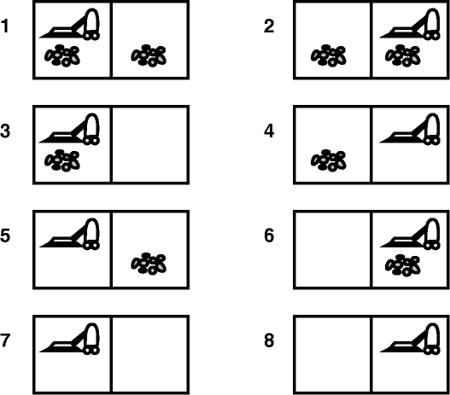
Example- Vacuum World
In this case there are eight possible world states.
There are three possible actions: left, right, and suck.
The goal is to clean up all the dirt, i.e.,
the goal is equivalent to the set of states 7,8.
AI

Slide 7
Example - Route-Finding in Romania
initial states: Arad
goal state: Bucharest
operators: successor function S(x ) set of possible actions path cost: a function that assigns a cost to a path.
AI

Slide 8
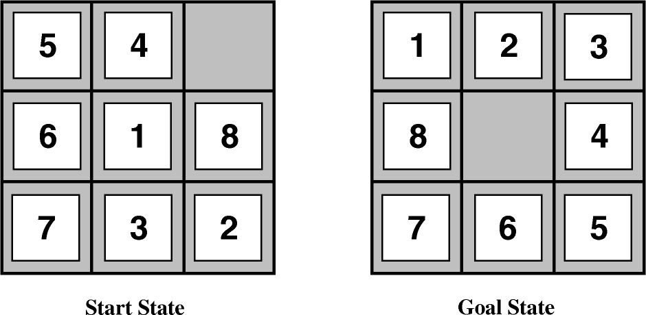
Example - The 8-puzzle problem
states: a state description specifies the location of each of the eight tiles in one of the nine squares. For efficiency it is also useful to include a location for the blank.
operators: blank moves left, right, up or down.
goal test: as in figure
path cost: length of path
AI

Slide 9
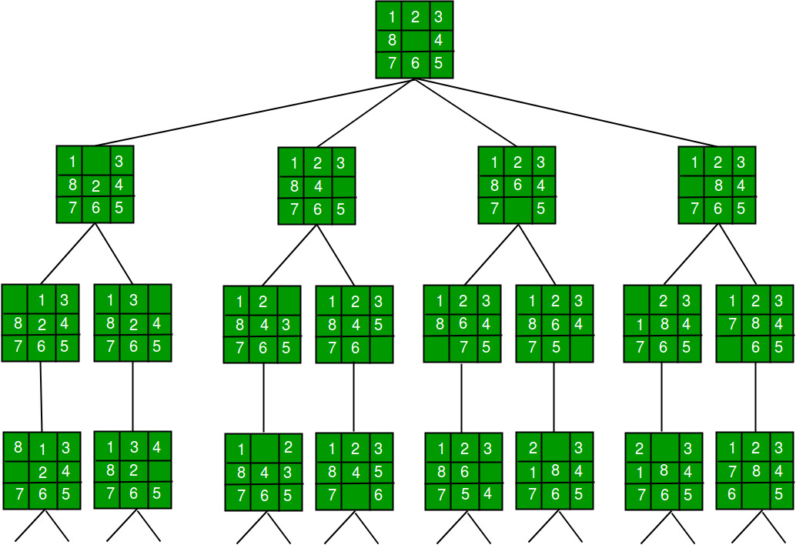
Space tree of 8 puzzle problem
Step by step approach:
Start from the root node.
Explore the leftmost child node recursively until you reach a leaf node or a goal state.
If a goal state is reached, return the solution.
If a leaf node is reached without finding a solution, backtrack to explore other branches

Slide 10
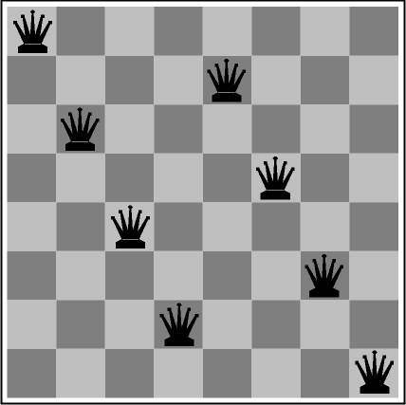
Example - The 8-queens problem
The goal of this problem is to place 8 queens on the board so that none can attack the others. The following is not a solution!
goal test: 8 queens on board, none attacked path cost: irrelevant
states: any arrangement of 0-8 queens on the board operators: add or remove a queen to/from any square
AI
11 / 37

Slide 11
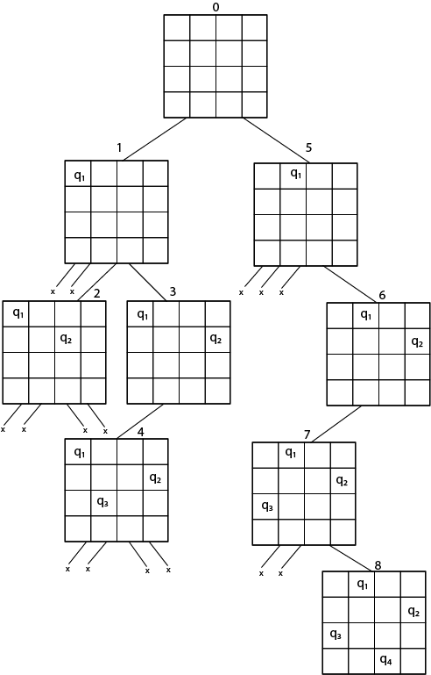
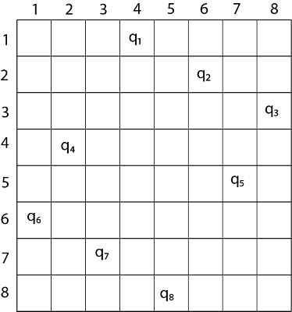
Possible solution

Slide 12
State space graph
A state space graph is a mathematical representation of a search problem.
Nodes are (abstracted) world configurations
Arcs represent transitions resulting from actions
The goal test is a set of goal nodes
Each state occurs only once
AI

Slide 13
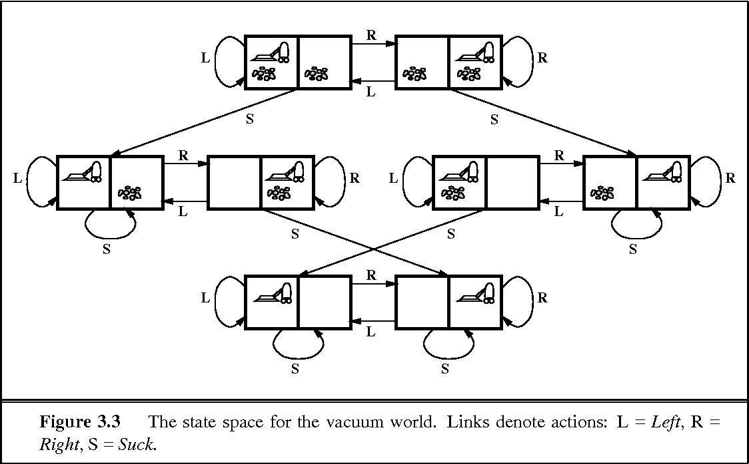
The state space for the vacuum world.
AI

Slide 14
Searching for Solutions
We can use a search algorithms to find a solution to a search problem.
In particular, we can find a path (i.e. sequence of actions) from the start state to the goal state in the state space graph.
Search algorithms can be uninformed search methods or
informed search methods.
A solution is an action sequence, so search algorithms work by considering various possible action sequences.
The SEARCH TREE possible action sequences starting at the initial state form a search tree with the initial state at the root; the branches are actions and the nodes correspond to states in the state space of the problem.
AI

Slide 15
Searching for Solutions-cont
By expanding the current state; that is, applying each legal action to the current state, thereby generating a new set of states.
After expanding Arad, add three branches from the parent node, leading to three new child nodes
After expanding Sibiu these six nodes is a leaf node, The set of all leaf nodes available for expansion at any given point is called the frontier. (Many authors call it the open list)
The process of expanding nodes on the frontier continues until either a solution is found or there are no more states to expand.
AI

Slide 16
Searching for Solutions-cont
The way to avoid exploring redundant paths is to remember, TREE-SEARCH algorithm with a data structure called the explored set (also known as the closed list), which remembers every expanded node(visited).
Newly generated nodes that match previously generated nodes—ones in the explored set or the frontier—can be discarded instead of being added to the frontier.
Search algorithms all share this basic structure; they vary primarily according to how they choose which state to expand next—the so-called search strategy.
The frontier needs to be stored in such a way that the search algorithm can easily choose the next node to expand according to its preferred strategy.
AI

Slide 17
Search strategy and Data Structure
The appropriate data structure for the search strategy is a queue. Three common variants are:
the first-in, first-out or FIFO queue, which pops the oldest element of the queue;
the last-in, first-out or LIFO queue (also known as a stack), which pops the newest element of the queue;
the priority queue, which pops the element of the queue with the highest priority according to some ordering function.
AI

Slide 18
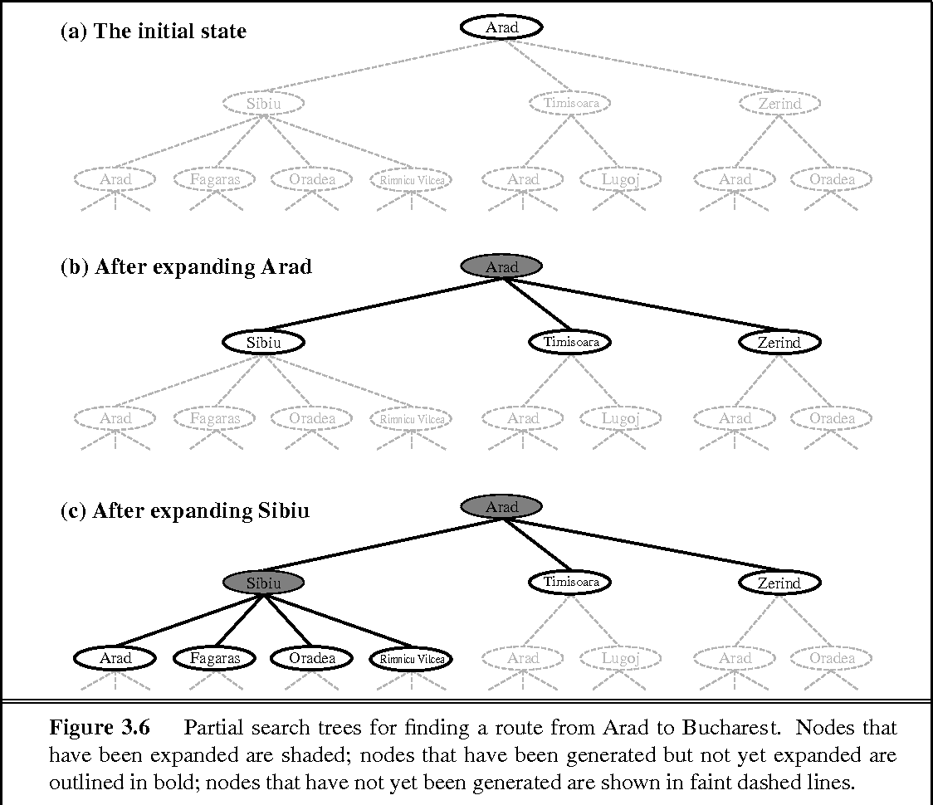
Partial search trees for finding a route
AI

Slide 19
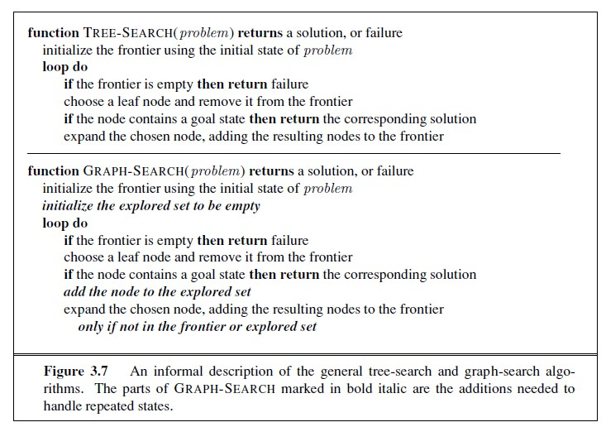
General tree-search and graph-search algorithms
AI

Slide 20
Measuring problem-solving performance
completeness: is the strategy guaranteed to find a solution when there is one?
optimality: does the search strategy find the highest quality solution when there are multiple solutions?
time complexity: how long does it take to find a solution?
space complexity: how much memory is required to perform the search?
AI

Slide 21
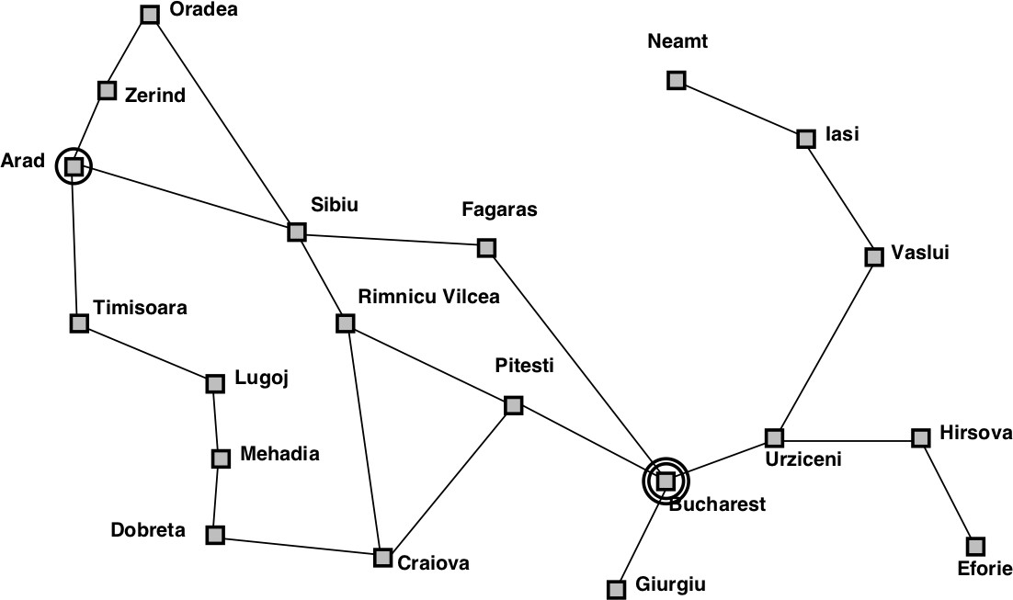
Breadth-first search
Strategy: expand shallowest node first Implementation: Fringe is a FIFO queue
AI

Slide 22
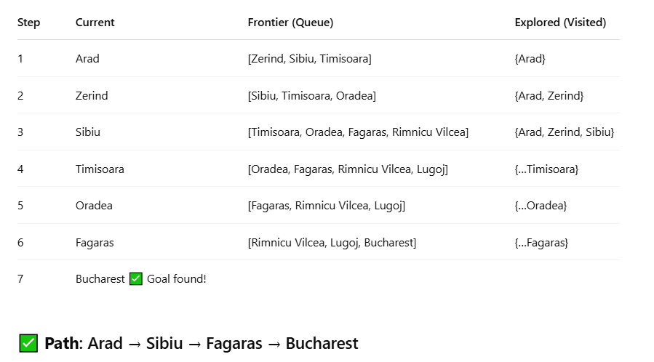
BFS

Slide 23
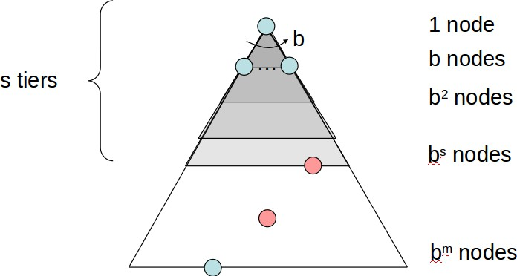
Properties of Breadth-first search
Complete: Guaranteed to find a solution if one exists? Yes (if b is finite)
Optimal: Guaranteed to find the least cost path? Yes (if cost = 1 per step); not optimal in general
Time: 1 + b + b² + b³ + . . . + b^{d} = O(b^{d} ), i.e., exponential in d
Space: O(b^{d} ) (keeps every node in memory)[b=branch, d=depth]
Space is the big problem; can easily generate nodes at 1MB/sec so 24hrs = 86GB.
AI

Slide 24
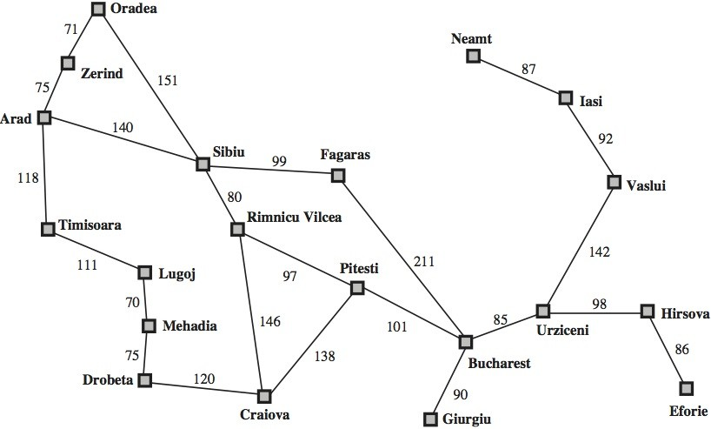
Uniform-cost search
Instead of expanding the shallowest node, uniform-cost search expands the node n with the lowest path cost g(n)
AI

Slide 25
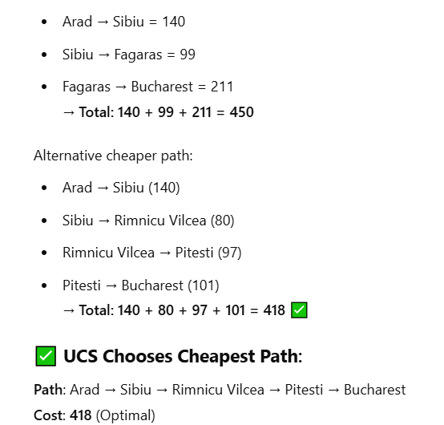
UCS

Slide 26
Depth-first search
Strategy: expand deepest node first Implementation: Fringe is a LIFO queue (a stack)
AI

Slide 27
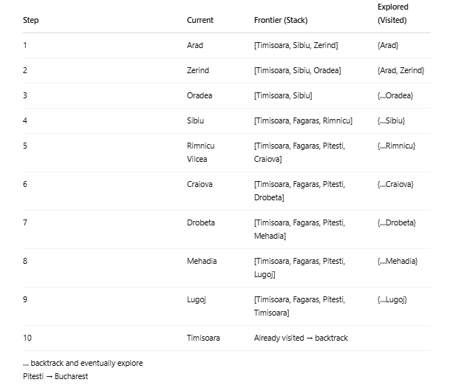
DFS
Arad → Sibiu → Rimnicu Vilcea → Pitesti → Bucharest

Slide 28
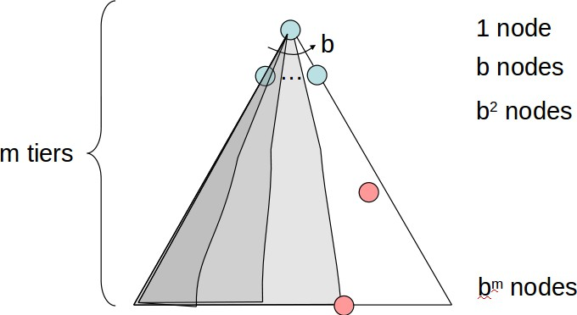
Properties of Depth-first search
Complete: No. fails in infinite-depth spaces, spaces with loops Modify to avoid repeated states along path
⇒ complete in finite spaces
Optimal: No
Time: O(b^{m}): terrible if m is much larger than d
but if solutions are dense, may be much faster than breadth-first
Space: O(bm), i.e., linear space!
AI

Slide 29
Depth-limited search
depth-first search with depth limit L
Implementation: Nodes at depth L have no successors
AI

Slide 30
Iterative deepening search
Iterative deepening search (or iterative deepening depth-first search) is a general strategy, often used in combination with depth-first tree search, which finds the best depth limit.
It does this by gradually increasing the limit—first 0, then 1, then 2, and so on—until a goal is found
AI

Slide 31
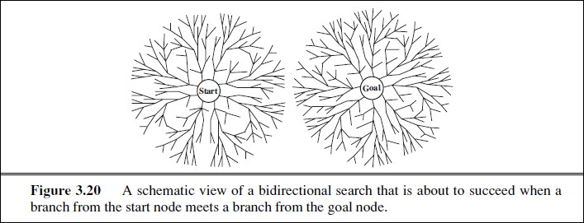
Bidirectional search
AI

Slide 32
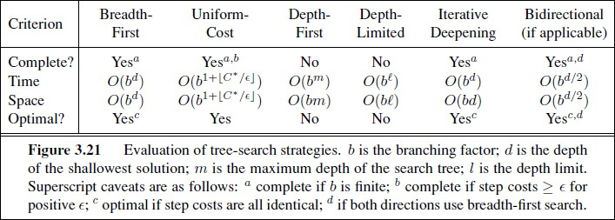
Comparing uninformed search
AI

Slide 33
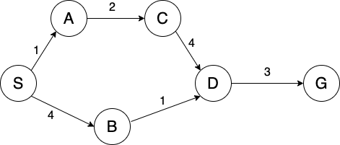
Exercise/Home Work
Simulate BFS,DFS,UCS using the graph. Show the expand tree, explored set(visited), Frontier and path cost
AI

Slide 34
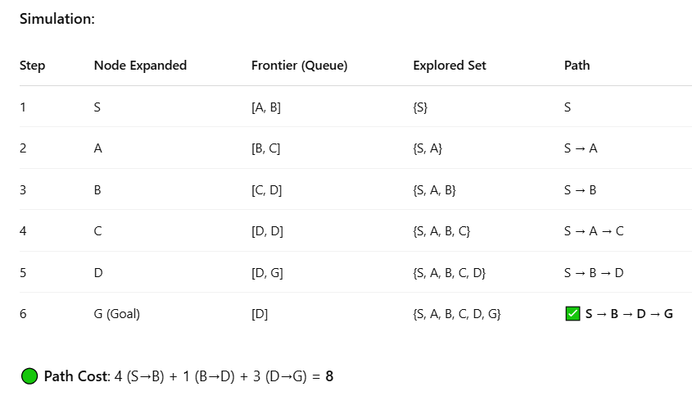
BFS

Slide 35
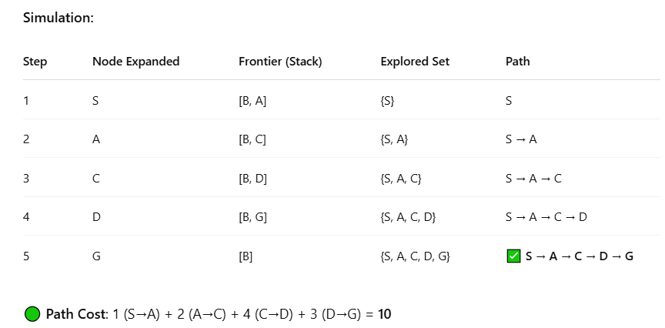
DFS

Slide 36
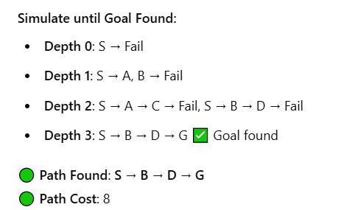
IDS

Slide 37
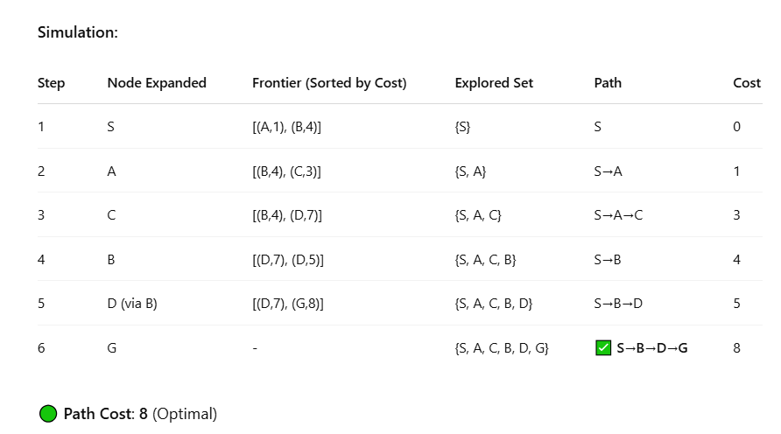
UCS

Slide 38
References
Stuart Russell and Peter Norvig. 2009. Artificial Intelligence: A Modern Approach (3rd ed.). Prentice Hall Press, Upper Saddle River, NJ, USA.
https://www.cs.cmu.edu/ 15281/coursenotes/search/ https://inst.eecs.berkeley.edu/ cs188/fa24/ https://ai.berkeley.edu/course schedule.html https://inst.eecs.berkeley.edu/ cs188/su24/
AI

